Slide 1
HIGHER ORDER SQUARE MATRICES
MATH 15 - Linear Algebra

Slide 2
PROPERTIES OF DETERMINANTS
For all square matrices, the following properties hold:
If a row or a column of a given matrix is a multiple or equal to another row or column, then the determinant is equal to 0.
If a row or a column of a matrix consists entirely of zeroes, then its determinant is equal to zero.
The determinant of a matrix is equal to the determinant of its transpose.
When matrix multiplication is possible, the product of the determinants of the given matrices is equal to the determinant of the product.

Slide 3
PROPERTIES OF DETERMINANTS
For all square matrices, the following properties hold:
Interchanging two rows or two columns will make the determinant negative.
Constants can be factored from a single row or column of a matrix.
Adding a multiple of another row to a given matrix would not change the determinant of the matrix.
The determinant of a triangular matrix is the product of its diagonal elements.

Slide 4
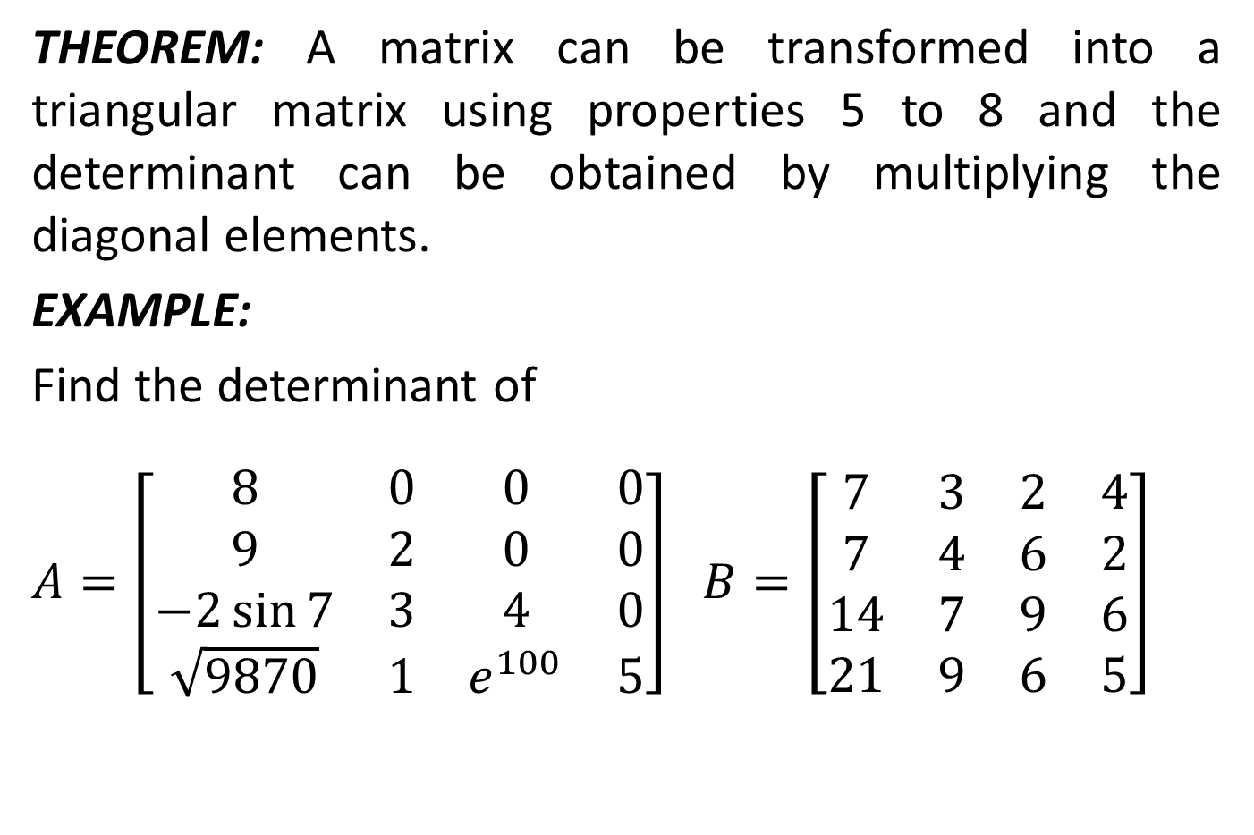
TRIANGULAR METHOD
THEOREM: A matrix can be transformed into a triangular matrix using properties 5 to 8 and the determinant can be obtained by multiplying the diagonal elements.
EXAMPLE:
Find the determinant of
$A=\left[\begin{matrix}8 & 0 & 0 & 0 \\ 9 & 2 & 0 & 0 \\ −2\sin{7} & 3 & 4 & 0 \\ \sqrt{9870} & 1 & e^{100} & 5\end{matrix}\right]$ $B=\left[\begin{matrix}7 & 3 & 2 & 4 \\ 7 & 4 & 6 & 2 \\ 14 & 7 & 9 & 6 \\ 21 & 9 & 6 & 5\end{matrix}\right]$

Slide 5
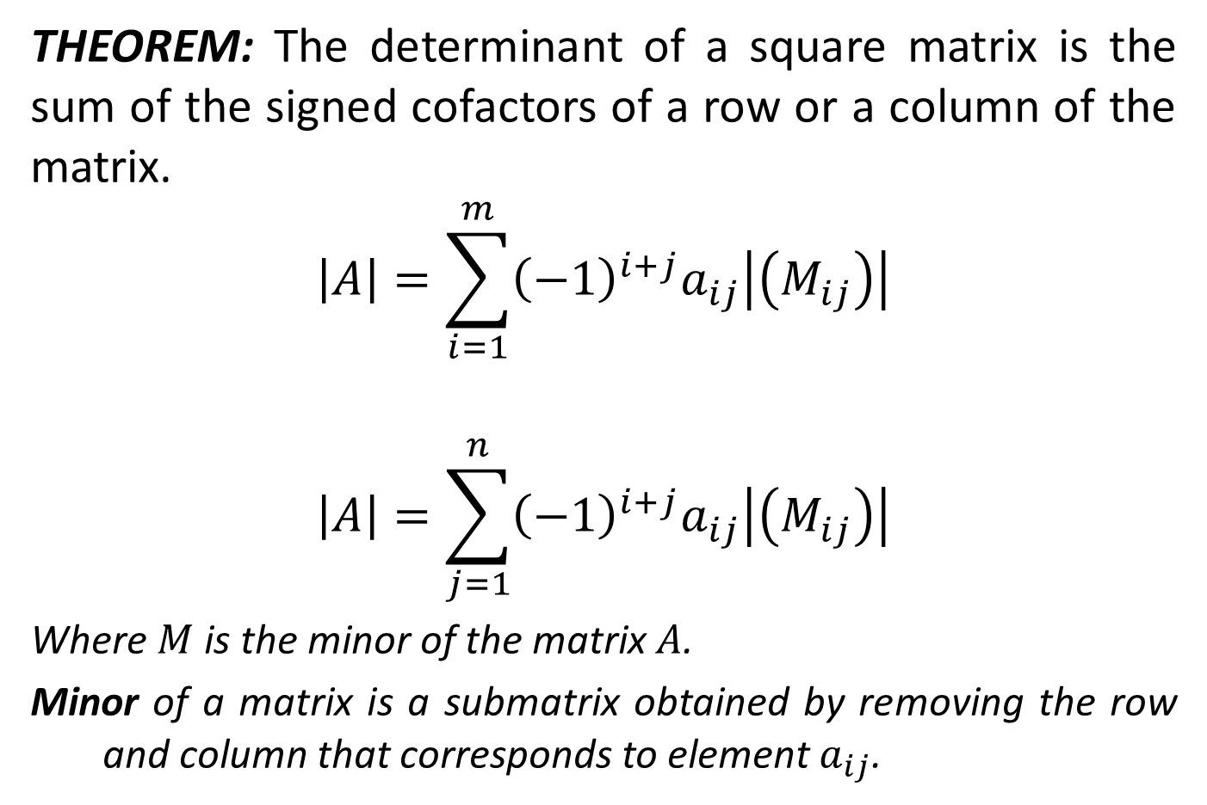
COFACTOR EXPANSION METHOD
THEOREM: The determinant of a square matrix is the sum of the signed cofactors of a row or a column of the matrix.
$$\left|A\right|=\sum_{i=1}^{m}{{\left(−1\right)}^{i+j}a_{ij}\left|\left(M_{ij}\right)\right|}$$
$$\left|A\right|=\sum_{j=1}^{n}{{\left(−1\right)}^{i+j}a_{ij}\left|\left(M_{ij}\right)\right|}$$
Where $M$ is the minor of the matrix $A$.
Minor of a matrix is a submatrix obtained by removing the row and column that corresponds to element $a_{ij}$.

Slide 6
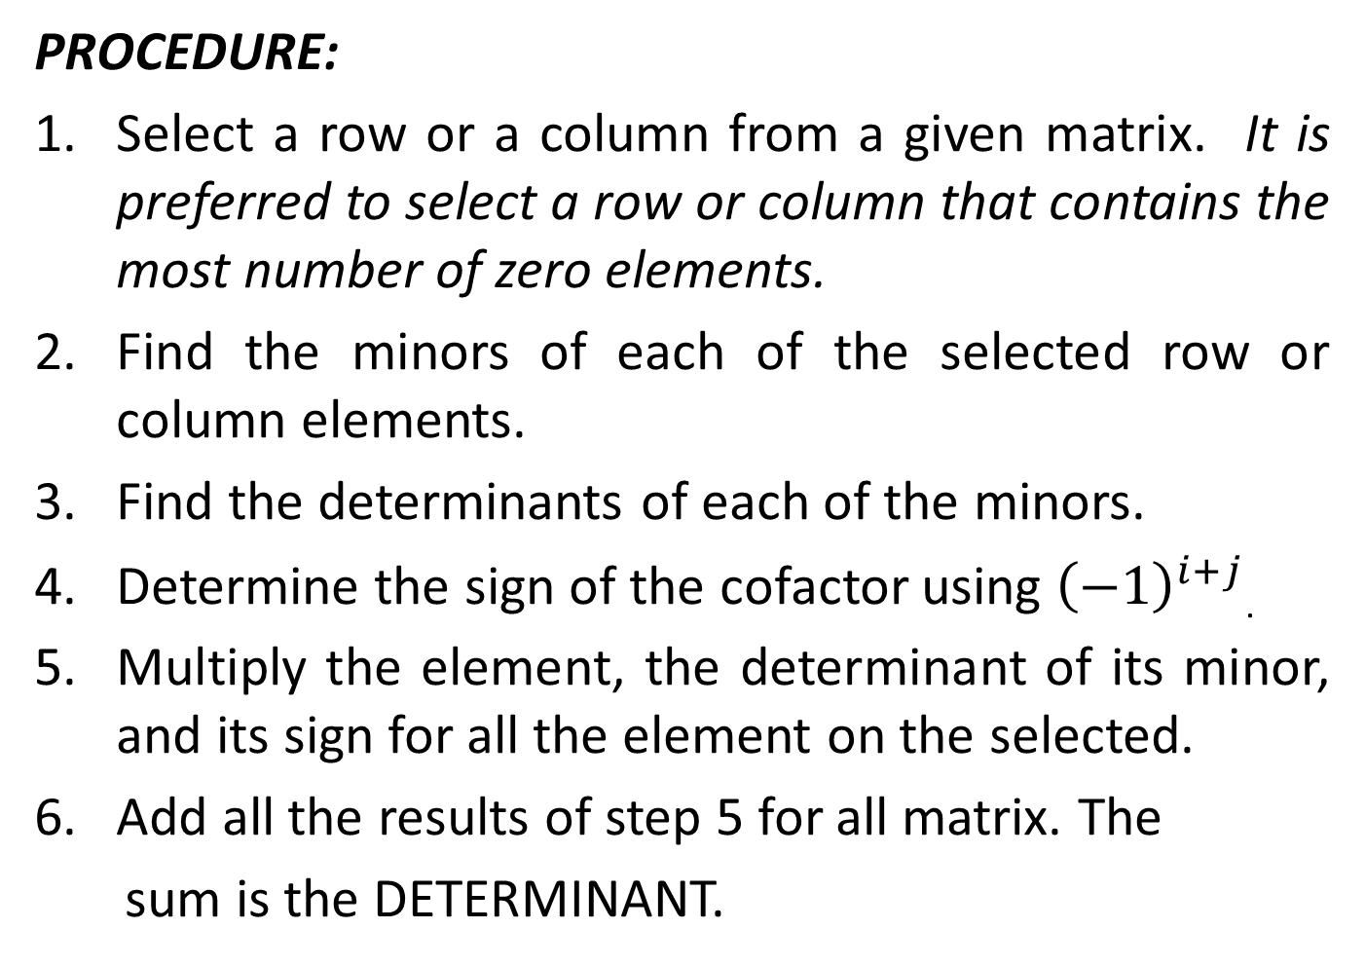
COFACTOR EXPANSION METHOD
PROCEDURE:
Select a row or a column from a given matrix. It is preferred to select a row or column that contains the most number of zero elements.
Find the minors of each of the selected row or column elements.
Find the determinants of each of the minors.
Determine the sign of the cofactor using ${\left(−1\right)}^{i+j}$.
Multiply the element, the determinant of its minor, and its sign for all the element on the selected.
Add all the results of step 5 for all matrix. The
sum is the DETERMINANT.

Slide 7

COFACTOR EXPANSION METHOD
For the following matrix compute the cofactors $C_{12}$, $C_{24}$, and $C_{32}$.
$$A=\left[\begin{matrix}4 & 0 & 10 & 4 \\ −1 & 2 & 3 & 9 \\ 5 & −5 & −1 & 6 \\ 3 & 7 & 1 & −2\end{matrix}\right]$$

Slide 8
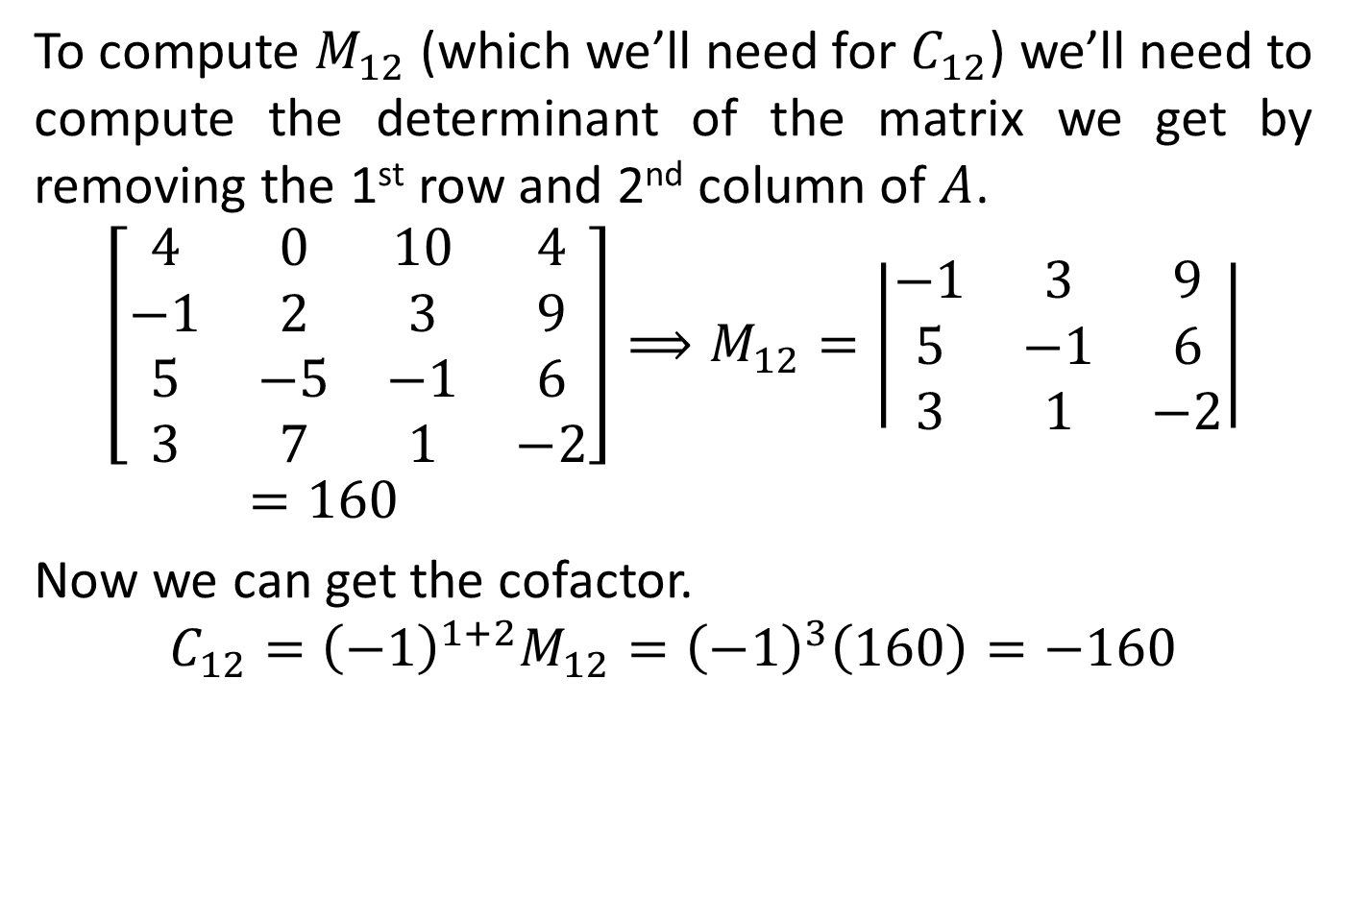
COFACTOR EXPANSION METHOD
To compute $M_{12}$ (which we’ll need for $C_{12}$) we’ll need to compute the determinant of the matrix we get by removing the 1st row and 2nd column of $A$.
$$\left[\begin{matrix}4 & 0 & 10 & 4 \\ −1 & 2 & 3 & 9 \\ 5 & −5 & −1 & 6 \\ 3 & 7 & 1 & −2\end{matrix}\right]⟹M_{12}=\left|\begin{matrix}−1 & 3 & 9 \\ 5 & −1 & 6 \\ 3 & 1 & −2\end{matrix}\right|=160$$
Now we can get the cofactor.
$$C_{12}={\left(−1\right)}^{1+2}M_{12}={\left(−1\right)}^{3}\left(160\right)=−160$$

Slide 9
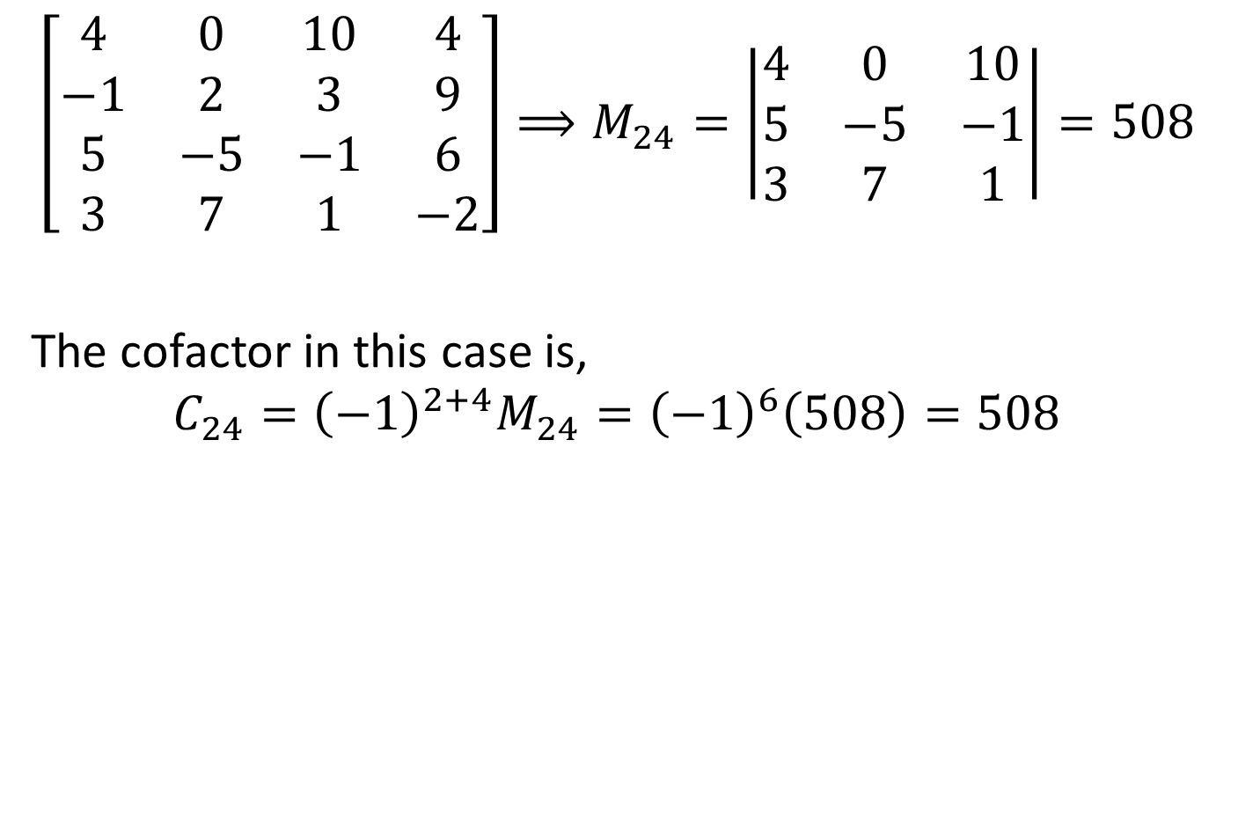
COFACTOR EXPANSION METHOD
$$\left[\begin{matrix}4 & 0 & 10 & 4 \\ −1 & 2 & 3 & 9 \\ 5 & −5 & −1 & 6 \\ 3 & 7 & 1 & −2\end{matrix}\right]⟹M_{24}=\left|\begin{matrix}4 & 0 & 10 \\ 5 & −5 & −1 \\ 3 & 7 & 1\end{matrix}\right|=508$$
The cofactor in this case is,
$$C_{24}={\left(−1\right)}^{2+4}M_{24}={\left(−1\right)}^{6}\left(508\right)=508$$

Slide 10

COFACTOR EXPANSION METHOD
$$\left[\begin{matrix}4 & 0 & 10 & 4 \\ −1 & 2 & 3 & 9 \\ 5 & −5 & −1 & 6 \\ 3 & 7 & 1 & −2\end{matrix}\right]⟹M_{32}=\left|\begin{matrix}4 & 10 & 4 \\ −1 & 3 & 9 \\ 3 & 1 & −2\end{matrix}\right|=150$$
$$C_{32}={\left(−1\right)}^{3+2}M_{32}={\left(−1\right)}^{5}\left(150\right)=−150$$

Slide 11
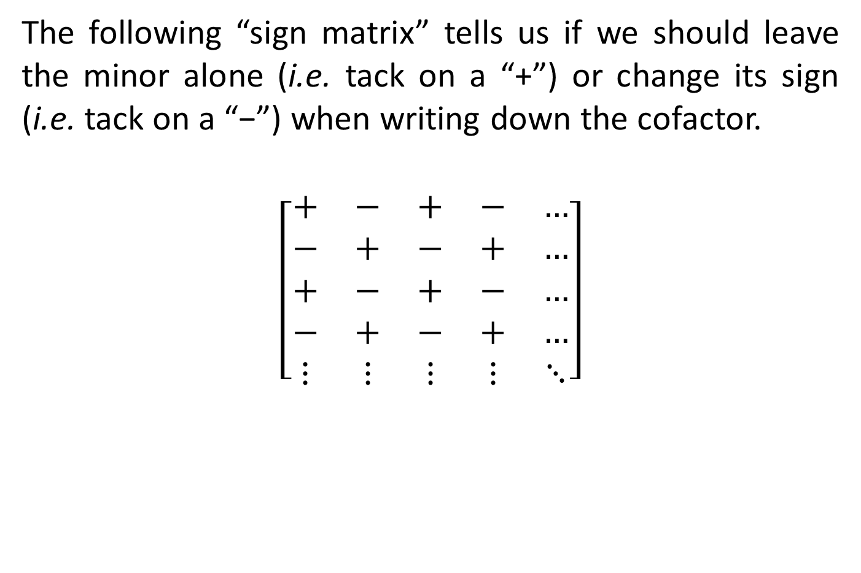
COFACTOR EXPANSION METHOD
The following “sign matrix” tells us if we should leave the minor alone (i.e. tack on a “+”) or change its sign (i.e. tack on a “−”) when writing down the cofactor.
$$\left[\begin{matrix}+ & − & + & − & … \\ − & + & − & + & … \\ + & − & + & − & … \\ − & + & − & + & … \\ ⋮ & ⋮ & ⋮ & ⋮ & ⋱\end{matrix}\right]$$

Slide 12
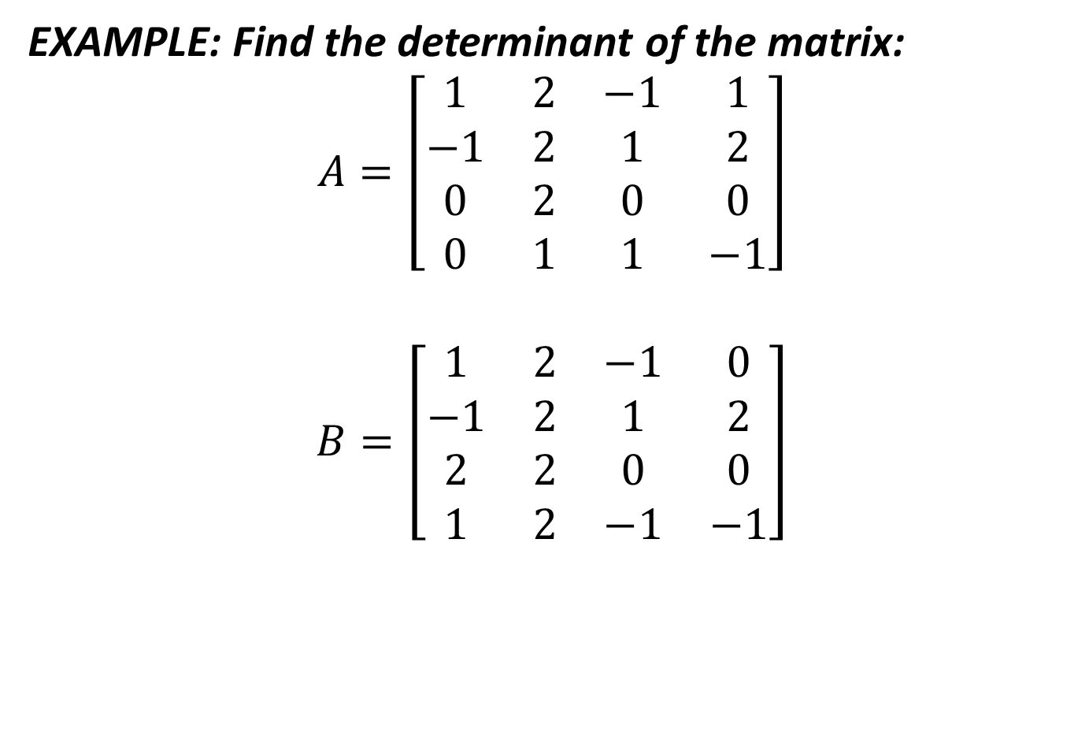
COFACTOR EXPANSION METHOD
EXAMPLE: Find the determinant of the matrix:
$$A=\left[\begin{matrix}1 & 2 & −1 & 1 \\ −1 & 2 & 1 & 2 \\ 0 & 2 & 0 & 0 \\ 0 & 1 & 1 & −1\end{matrix}\right]$$
$$B=\left[\begin{matrix}1 & 2 & −1 & 0 \\ −1 & 2 & 1 & 2 \\ 2 & 2 & 0 & 0 \\ 1 & 2 & −1 & −1\end{matrix}\right]$$

Slide 13
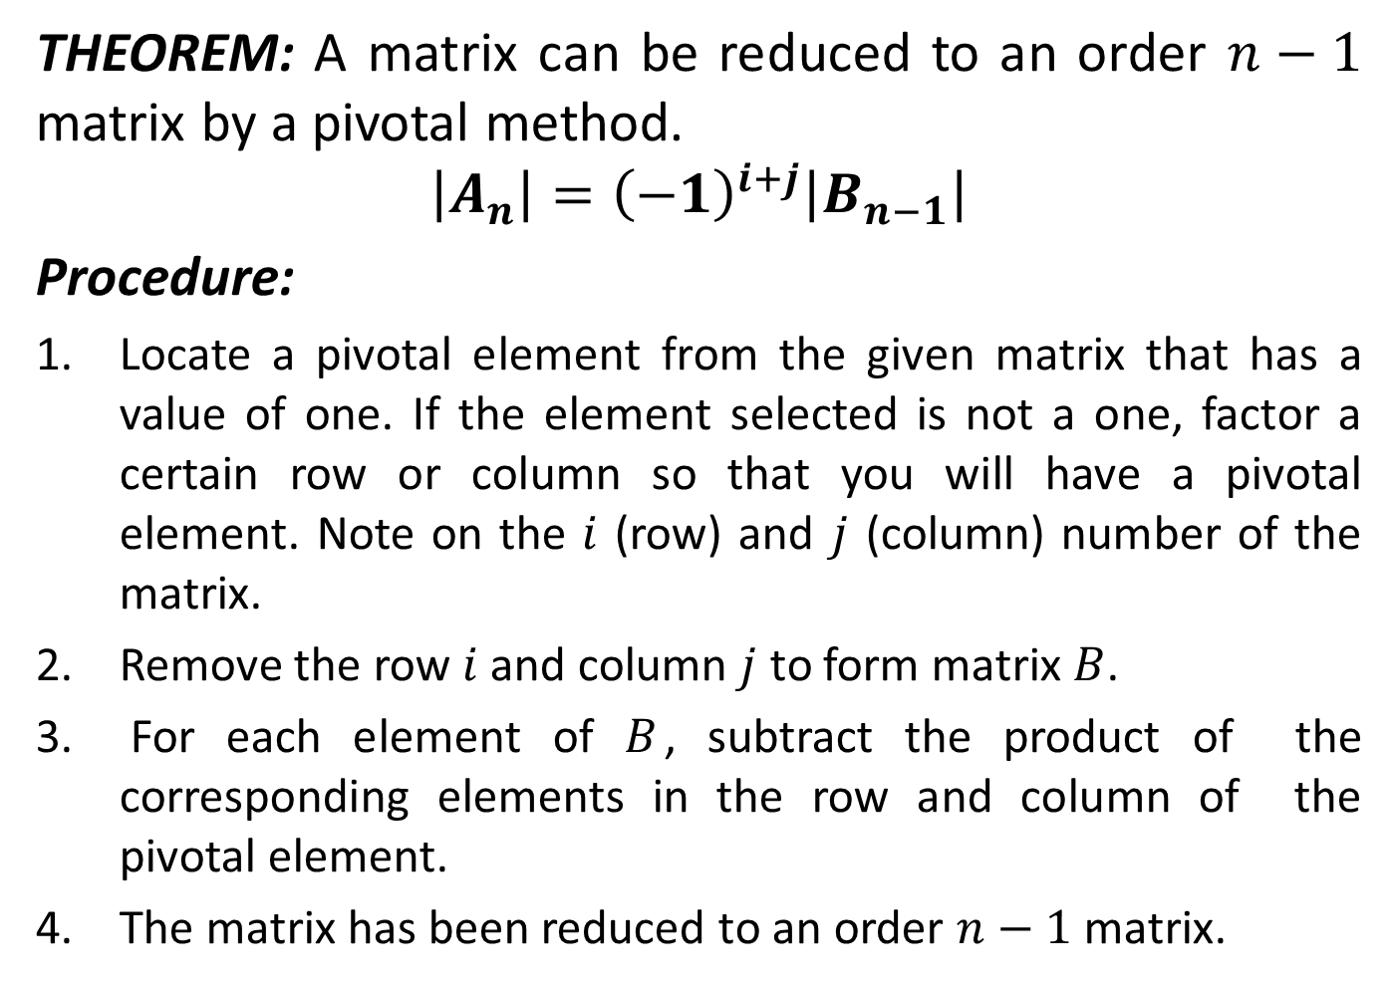
PIVOTAL METHOD
THEOREM: A matrix can be reduced to an order $n−1$ matrix by a pivotal method.
$$\left|A_{n}\right|={\left(−1\right)}^{i+j}\left|B_{n−1}\right|$$
Procedure:
Locate a pivotal element from the given matrix that has a value of one. If the element selected is not a one, factor a certain row or column so that you will have a pivotal element. Note on the $i$ (row) and $j$ (column) number of the matrix.
Remove the row $i$ and column $j$ to form matrix $B$.
For each element of $B$, subtract the product of the corresponding elements in the row and column of the pivotal element.
The matrix has been reduced to an order $n−1$ matrix.

Slide 14
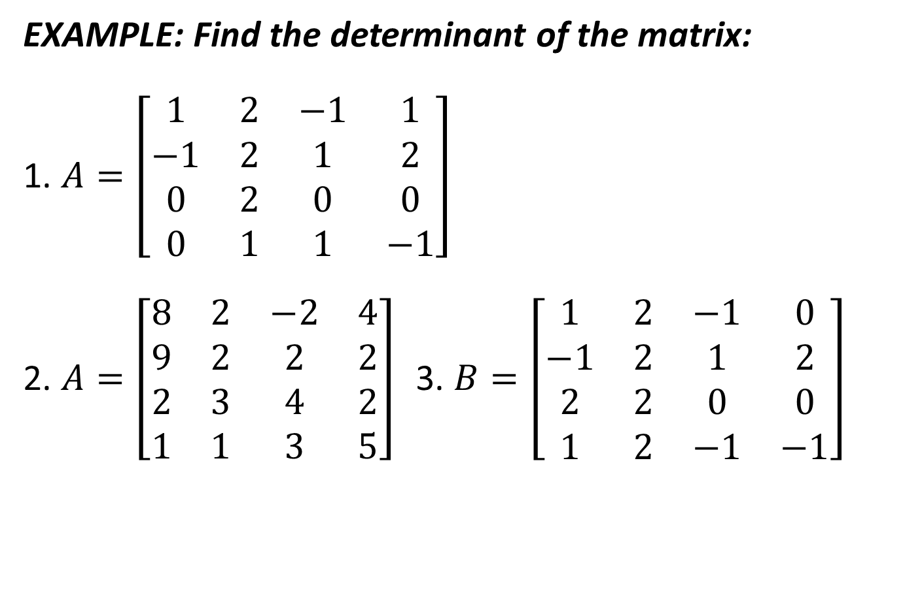
PIVOTAL METHOD
EXAMPLE: Find the determinant of the matrix:
1. $A=\left[\begin{matrix}1 & 2 & −1 & 1 \\ −1 & 2 & 1 & 2 \\ 0 & 2 & 0 & 0 \\ 0 & 1 & 1 & −1\end{matrix}\right]$
2. $A=\left[\begin{matrix}8 & 2 & −2 & 4 \\ 9 & 2 & 2 & 2 \\ 2 & 3 & 4 & 2 \\ 1 & 1 & 3 & 5\end{matrix}\right]$ 3. $B=\left[\begin{matrix}1 & 2 & −1 & 0 \\ −1 & 2 & 1 & 2 \\ 2 & 2 & 0 & 0 \\ 1 & 2 & −1 & −1\end{matrix}\right]$

Slide 15
APPLICATIONS OF DETERMINANTS
Determinants are useful tools in the following applications:
Solution to System Equation
Cramer’s Rule
2. Matrix Inversion
Adjoint (adjugate) of a matrix

Slide 16
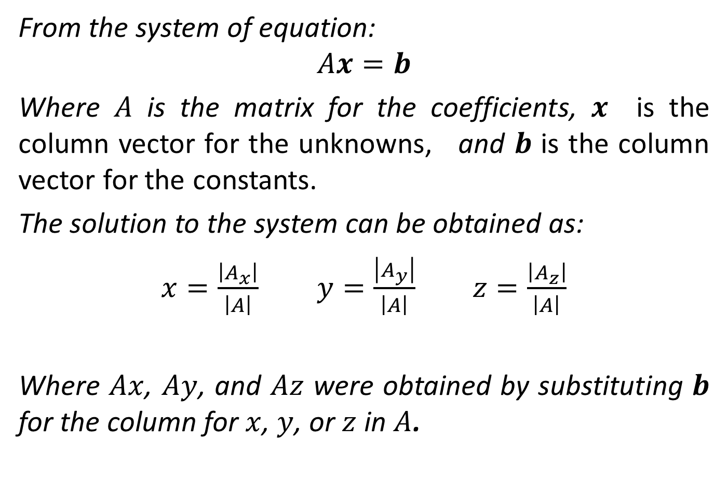
CRAMER’S RULE
From the system of equation:
$$Ax=b$$
Where $A$ is the matrix for the coefficients, $x$ is the column vector for the unknowns, and $b$ is the column vector for the constants.
The solution to the system can be obtained as:
$x=\frac{\left|A_{x}\right|}{\left|A\right|}$ $y=\frac{\left|A_{y}\right|}{\left|A\right|}$ $z=\frac{\left|A_{z}\right|}{\left|A\right|}$
Where $Ax$, $Ay$, and $Az$ were obtained by substituting $b$ for the column for $x$, $y$, or $z$ in $A$.

Slide 17
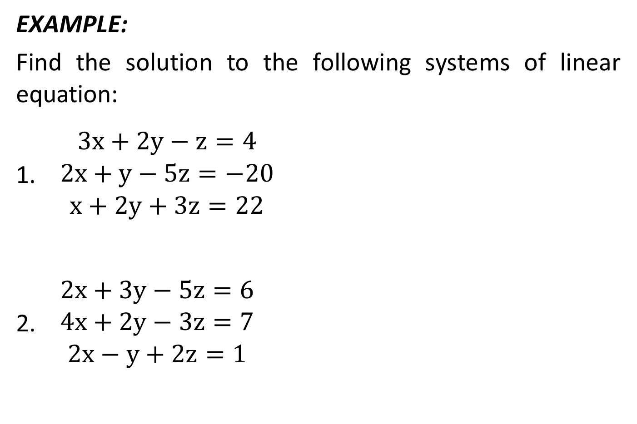
CRAMER’S RULE
EXAMPLE:
Find the solution to the following systems of linear equation:
$\begin{matrix}3x+2y−z=4 \\ 2x+y−5z=−20 \\ x+2y+3z=22\end{matrix}$
$\begin{matrix}2x+3y−5z=6 \\ 4x+2y−3z=7 \\ 2x−y+2z=1\end{matrix}$

Slide 18
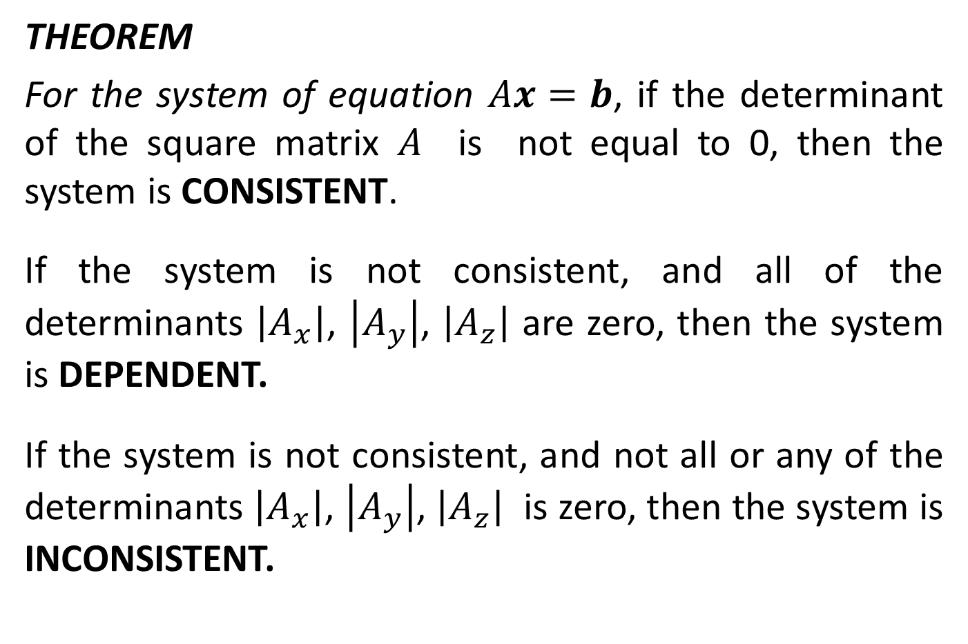
CRAMER’S RULE
THEOREM
For the system of equation $Ax=b$, if the determinant of the square matrix $A$ is not equal to 0, then the system is CONSISTENT.
If the system is not consistent, and all of the determinants $\left|A_{x}\right|$, $\left|A_{y}\right|$, $\left|A_{z}\right|$ are zero, then the system is DEPENDENT.
If the system is not consistent, and not all or any of the determinants $\left|A_{x}\right|$, $\left|A_{y}\right|$, $\left|A_{z}\right|$ is zero, then the system is INCONSISTENT.

Slide 19
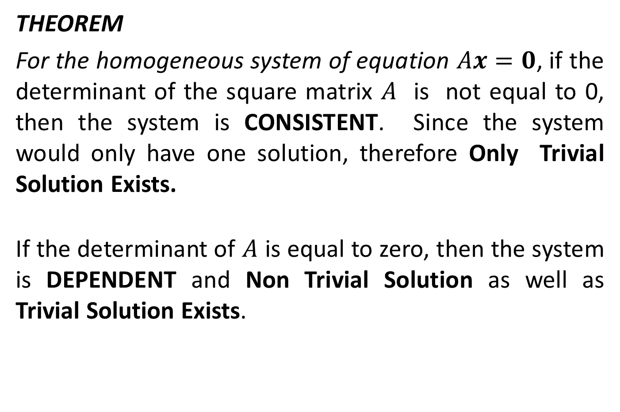
CRAMER’S RULE
THEOREM
For the homogeneous system of equation $Ax=0$, if the determinant of the square matrix $A$ is not equal to 0, then the system is CONSISTENT. Since the system would only have one solution, therefore Only Trivial Solution Exists.
If the determinant of $A$ is equal to zero, then the system is DEPENDENT and Non Trivial Solution as well as Trivial Solution Exists.

Slide 20
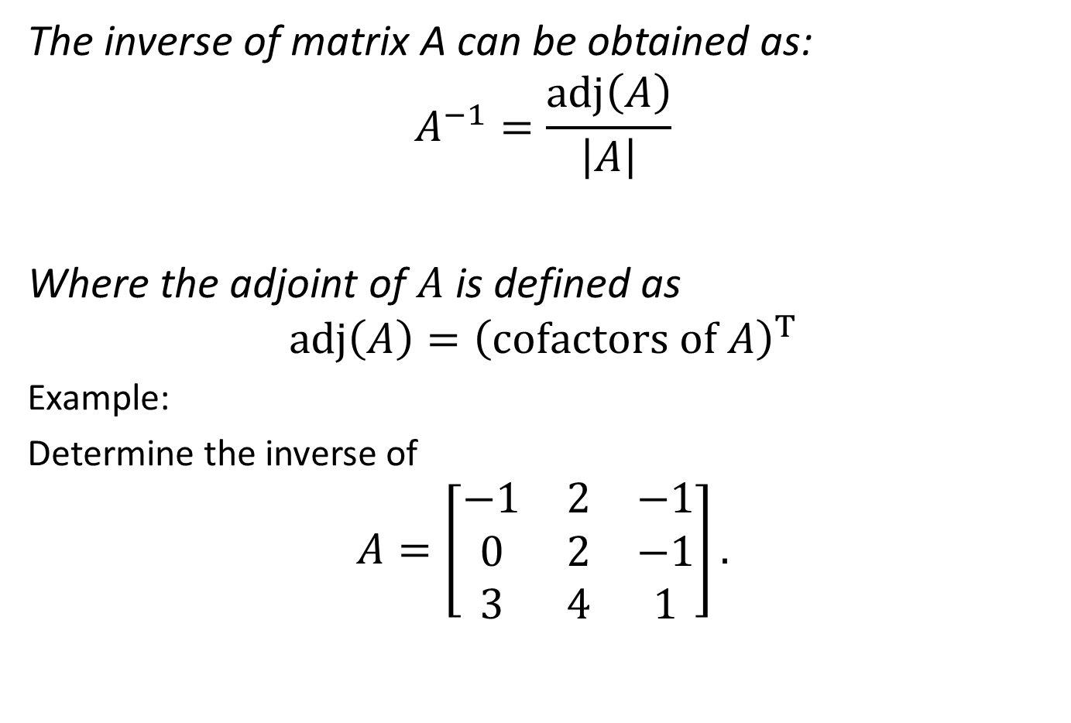
MATRIX INVERSION
The inverse of matrix A can be obtained as:
$$A^{−1}=\frac{\operatorname{adj}\left(A\right)}{\left|A\right|}$$
Where the adjoint of $A$ is defined as
$$\operatorname{adj}\left(A\right)={\left(cofactors of A\right)}^{T}$$
Example:
Determine the inverse of
$$A=\left[\begin{matrix}−1 & 2 & −1 \\ 0 & 2 & −1 \\ 3 & 4 & 1\end{matrix}\right].$$

Slide 21
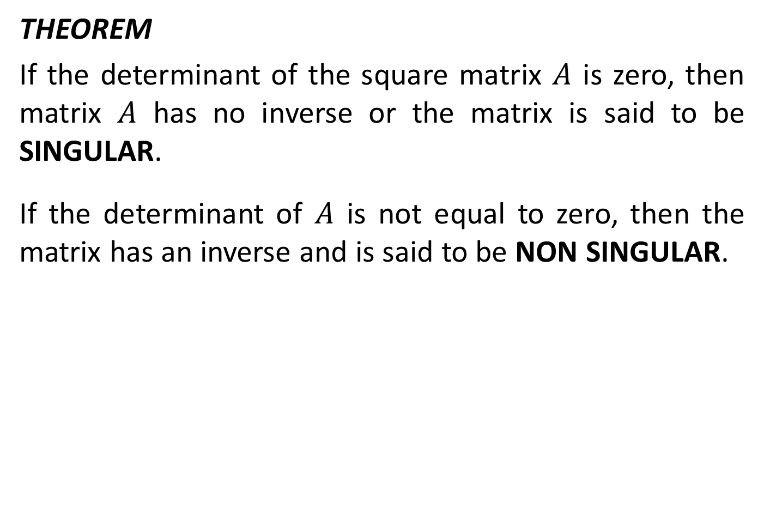
MATRIX INVERSION
THEOREM
If the determinant of the square matrix $A$ is zero, then matrix $A$ has no inverse or the matrix is said to be SINGULAR.
If the determinant of $A$ is not equal to zero, then the matrix has an inverse and is said to be NON SINGULAR.

Slide 22

EXAMPLE
Using Matrix Method, find the solution to the system.
$$\begin{matrix}−x+2y−z=5 \\ 2y−z=6 \\ 3x+4y+z=10\end{matrix}$$

Slide 23
SUGGESTED READINGS
TEXTBOOKS
Elementary Linear Algebra, Bernard Kolman and David R. Hill, 7th ed., 2003
Algebra and Trigonometry, James Stewart, Lothar Redlin and Saleem Watson, 2nd Ed 2010 P 752
WEBSITES:
http://en.wikipedia.org/wiki/Determinant
http://home.scarlet.be/~ping1339/determ.htm

